Slide 1




Enterprise LAN Design
Designing a secure, redundant LAN for a medium-sized enterprise, leveraging advanced networking technologies.
Project Title
LAN Design with Inter-VLAN Routing & EtherChannel
Objective
Implement a highly available and secure network infrastructure.

Slide 2






Core Technologies
VTP (VLAN Trunking Protocol)
Inter-VLAN Routing
Centralized VLAN management for efficiency.
Enabling communication between different network segments.
EtherChannel
Port Security
Increasing bandwidth and providing link redundancy.
Preventing unauthorized device access at the port level.

Slide 3


Network Scenario & IP Scheme
The enterprise network is segmented into three key departments, each with its dedicated VLAN and IP subnet.
10
172.31.10.0/24
172.31.10.1
HR
20
172.31.20.0/24
172.31.20.1
IT
30
172.31.30.0/24
172.31.30.1
Finance

Slide 4
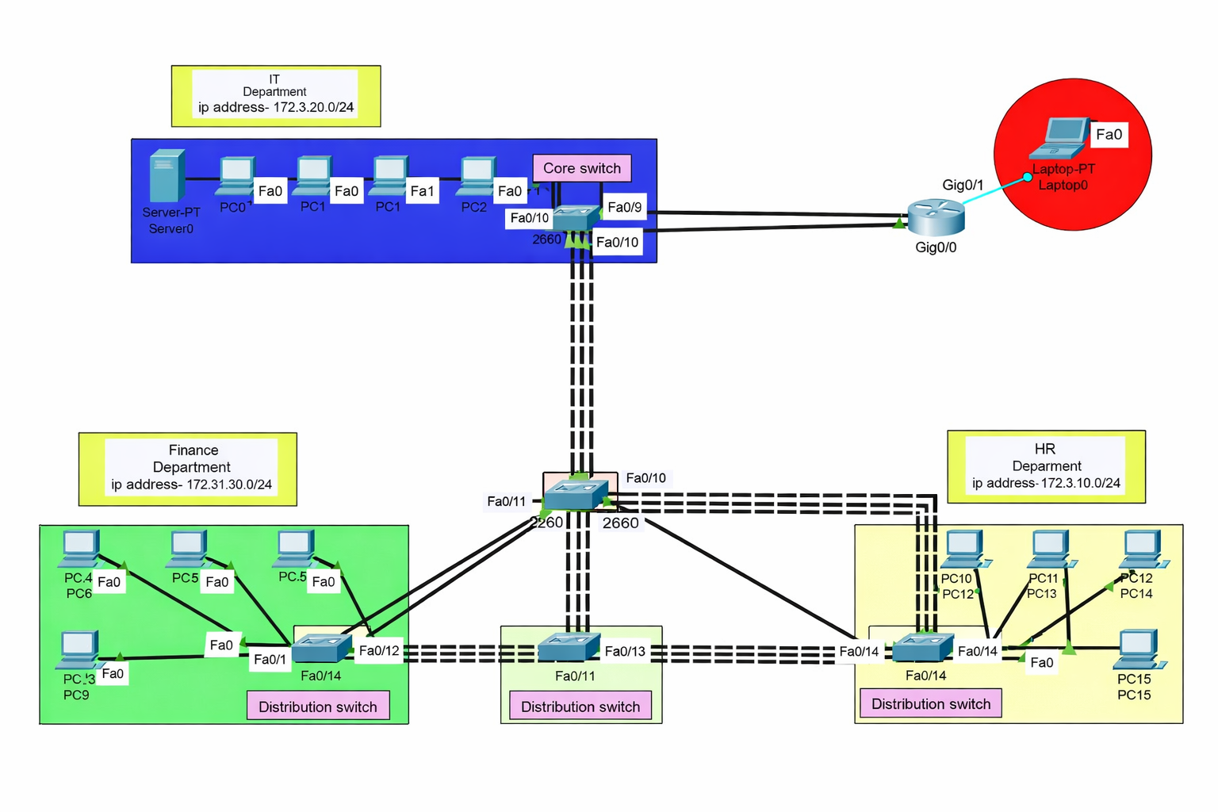



Slide 5



VTP Configuration
VTP Server (Core Switch)
Configured to centrally manage VLAN creation and propagation across the network.
vtp mode server
vtp domain MyEnterprise
vtp password cisco
vlan 10
vlan 20
vlan 30

Slide 6
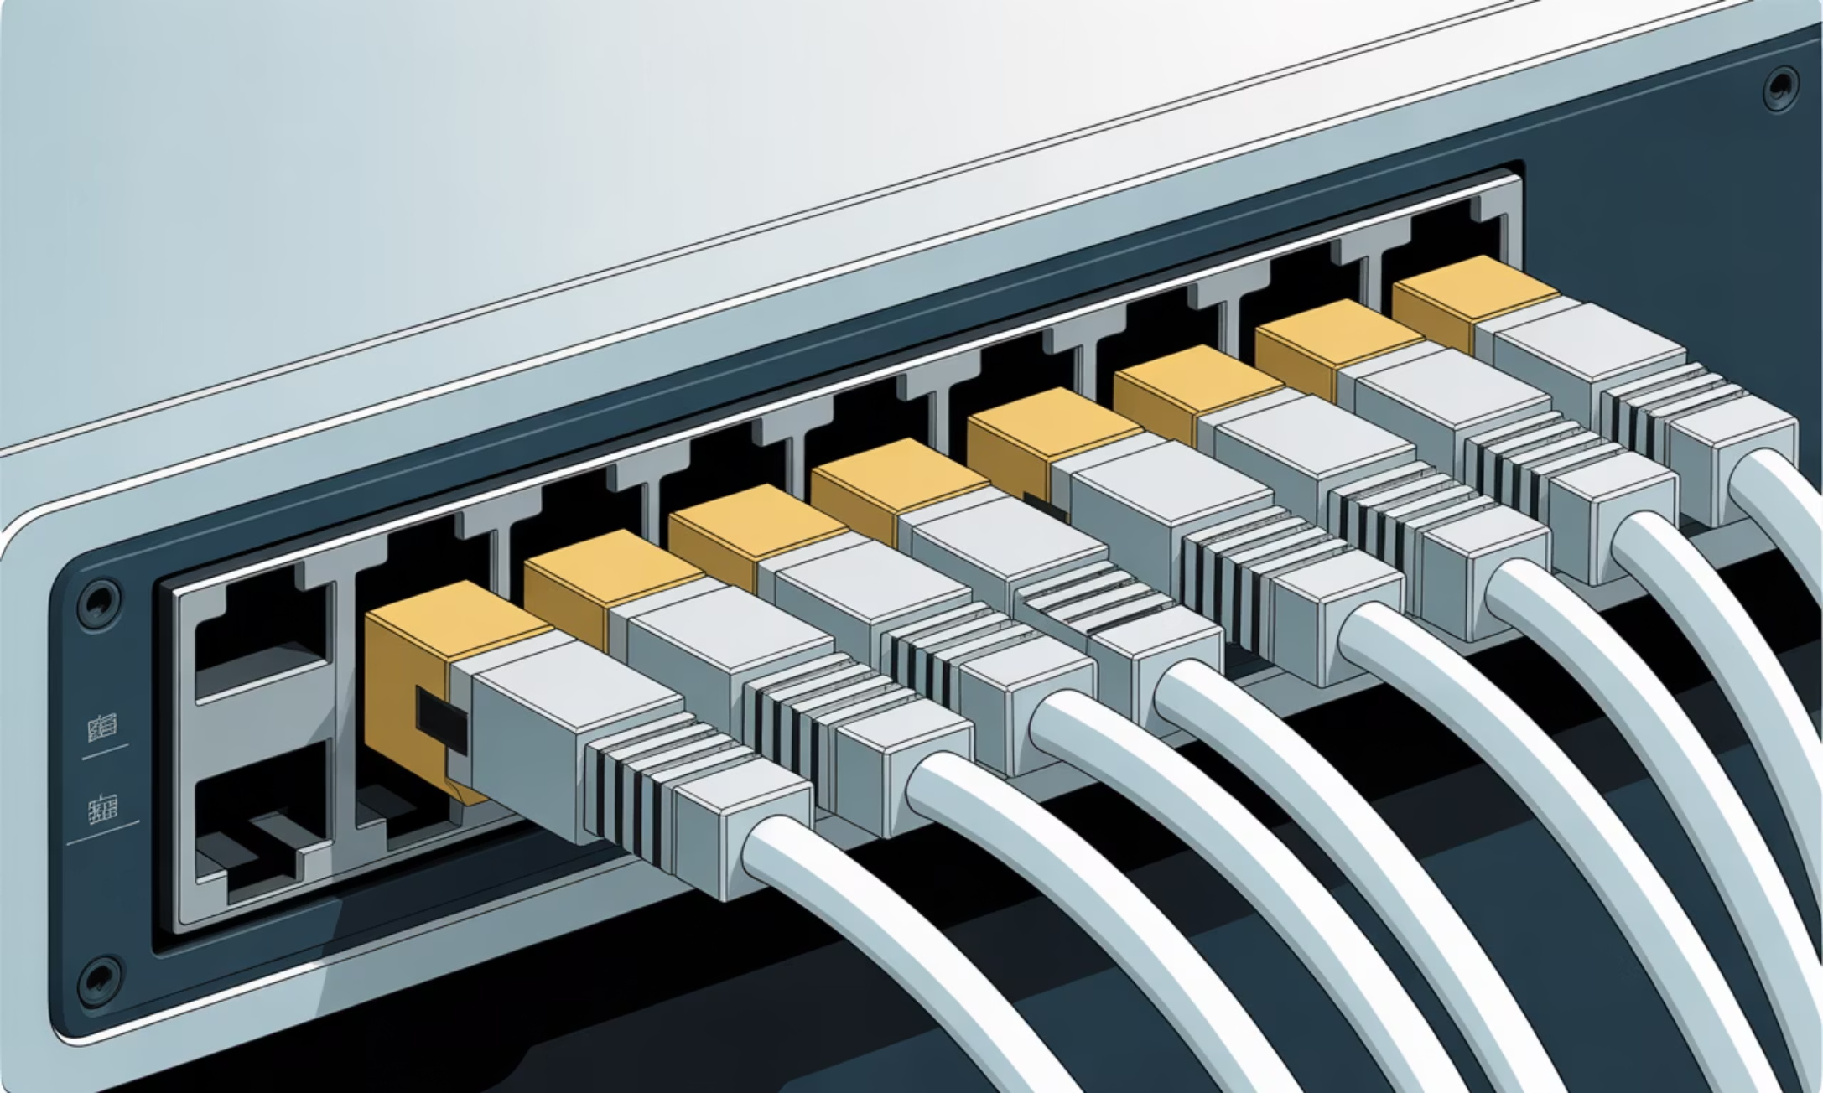


VTP Client Configuration
VTP Client (Distribution Switch)
Set to receive VLAN updates automatically from the VTP server, ensuring consistent VLAN information.
vtp mode client
vtp domain MyEnterprise
vtp password cisco

Slide 7


EtherChannel for High Availability
EtherChannel aggregates multiple physical links into a single logical link, enhancing bandwidth and providing redundancy between core and distribution switches.
1
2
3
Increased Bandwidth
Redundancy
Load Balancing
Combines links for higher data throughput.
Ensures network uptime if one link fails.
Distributes traffic across active links.

Slide 8



EtherChannel Commands (LACP)
These commands configure the interfaces for EtherChannel using Link Aggregation Control Protocol (LACP) in active mode, and set them as trunk ports for VLAN traffic.
interface range fa0/1 - 2
channel-group 1 mode active
switchport mode trunk

Slide 9
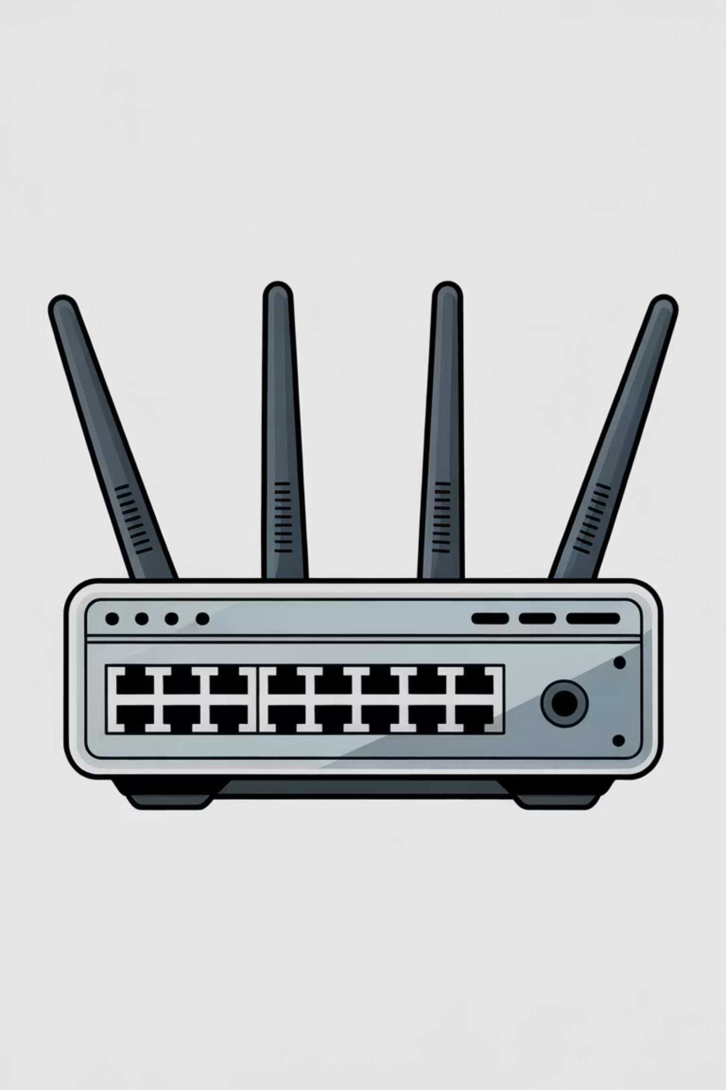
Inter-VLAN Routing
A single physical interface on the router is logically divided into sub-interfaces, each serving as the default gateway for a specific VLAN, enabling communication between different VLANs.
interface gi0/0.10
encapsulation dot1Q 10
ip address 172.31.10.1 255.255.255.0
interface gi0/0.20
encapsulation dot1Q 20
ip address 172.31.20.1 255.255.255.0

Slide 10




Router Security
Restricting Access
Implementing password protection on the console line to prevent unauthorized configuration changes.
line con 0
password cisco
login

Slide 11




Port Security Implementation
Unauthorized Device Prevention
Configuring access ports to allow only a specified number of MAC addresses, preventing rogue devices from connecting to the network.
interface fa0/5
switchport mode access
switchport port-security
switchport port-security maximum 2

